Slide 1

NexTalk: The AI Chatbot Revolution
Exploring the revolutionary impact of AI-powered conversational interfaces on industries.

Slide 2

INTRODUCTION
In today's digital era, businesses are constantly seeking innovative ways to enhance customer engagement and streamline communication processes. One such solution gaining traction is the implementation of chatbots – AI-powered virtual assistants capable of conversing with users in natural language. At the forefront of this technological advancement is NexTalk, our cutting-edge chatbot designed to revolutionize customer interactions and support services. With its advanced natural language processing capabilities and intuitive conversational interface, NexTalk aims to redefine the way customers interact with our brand and access information.

Slide 3



I. PROJECT SCOPE
The scope of the NexTalk project outlines its goals, functionalities, and limitations. It essentially establishes a roadmap for development, ensuring NexTalk stays focused and delivers on its intended purpose. Here are some key aspects to consider when defining NexTalk's scope:
1 - Functionality
2 - Integration
3 - Personalization
4 - Scalability
Virtual assistant to engage with customers
Multiple communication channels and platforms to ensure accessibility for users.
Tailors responses to individual user preferences and history.
NexTalk will be designed with scalability in mind to accommodate future growth and increased usage.
With these advanced features, NexTalk delivers a truly intelligent and natural conversational experience.

Slide 4
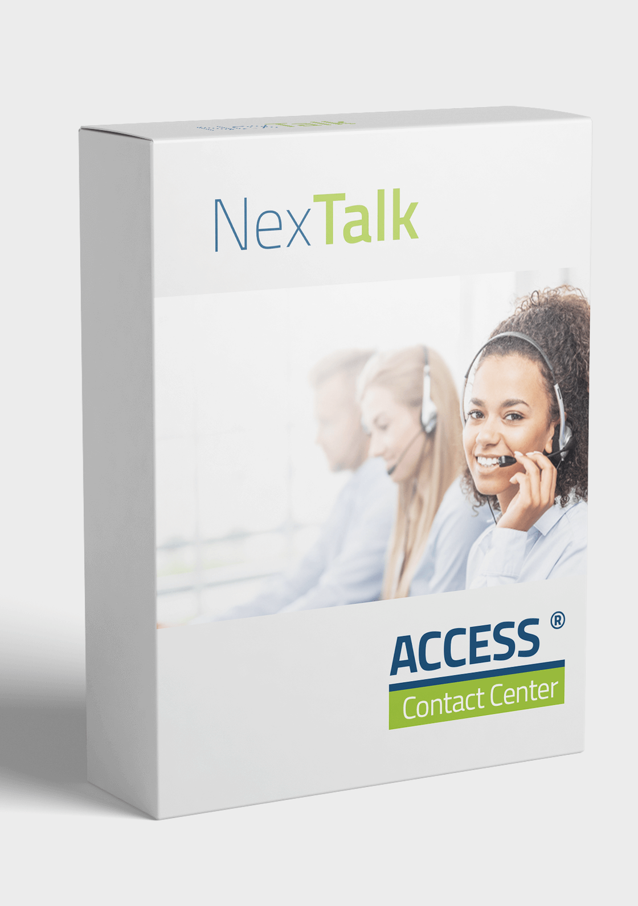
II. TECHNOLOGY STACK
The technology stack for NexTalk refers to the collection of programming languages, frameworks, libraries, and tools that will be used to build and operate the chatbot. Here's a breakdown of some key components:
1 - Programming Language: Python
2 - Natural Language Processing (NLP) Libraries
3 - Chatbot Frameworks
4 - Integration Platforms
By carefully considering these factors, the NexTalk development team can choose a technology stack that empowers them to build a robust, scalable, and effective chatbot.

Slide 5

III. NexTalk PROJECT PLAN
A well-defined project plan is essential for the successful development and launch of the NexTalk chatbot. Here's a breakdown of the key phases involved:
1 - Define Project Goals and Scope
NexTalk offers efficiency, cost-effectiveness, and improved user interactions. Whether it’s customer support, lead generation, or information dissemination, chatbots like NexTalk enhance organizational processes and user satisfaction.
3 - Research and Development
Research existing NLP and machine learning libraries/frameworks to identify suitable tools for NexTalk's development.
5 - Testing and Quality Assurance
Conduct thorough testing of NexTalk's functionalities, ensuring it behaves as expected and delivers accurate responses.
2 - Team Formation and Roles
Assemble a team with expertise in areas like NLP, machine learning, software development, and potentially user experience (UX) design.
Assign roles and responsibilities for each team member, ensuring clear ownership of tasks.
4 - Data Collection and Preparation
Gather relevant data for training NexTalk's NLP and machine learning models. This could include text data like FAQs, customer service transcripts, or dialogue examples.
6 - Deployment and Launch
Develop a launch strategy to create awareness and encourage users to interact with NexTalk.

Slide 6

IV. FONCTIONAL REQUIREMENTS
User Input and Understanding
Dialogue Management
Core Functionalities
Output and User Experience
Additional Functionalities (Optional)
Functional requirements define the specific tasks and functionalities NexTalk, the chatbot, must perform to meet its intended purpose. Here's a breakdown of key elements to consider:

Slide 7
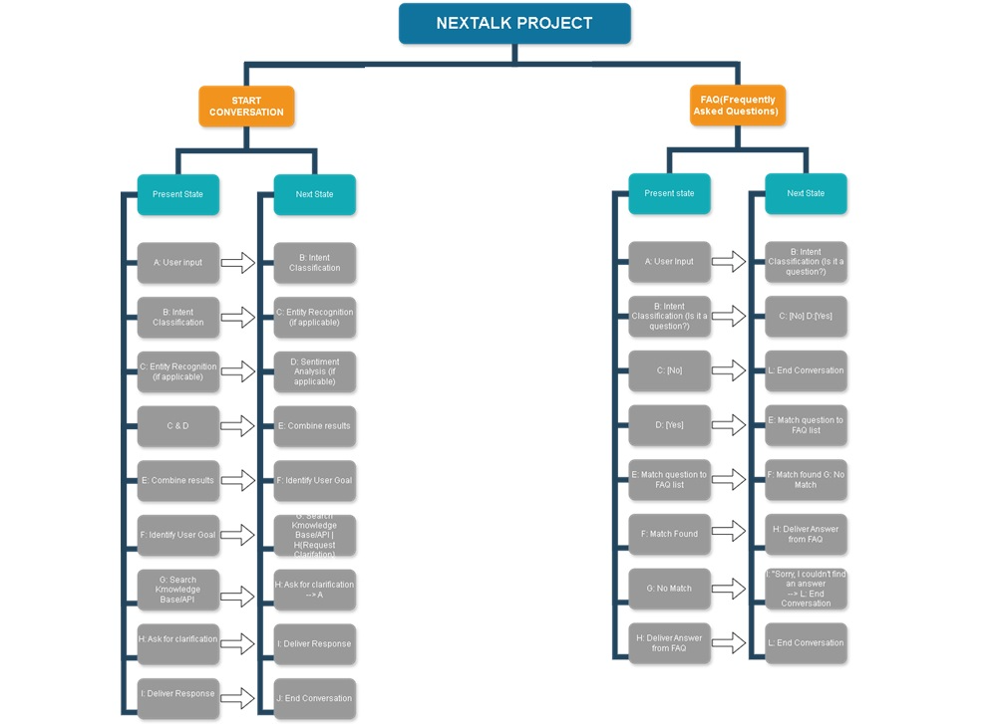
FLOWCHART

Slide 8
CONCLUSION
NexTalk has the potential to bridge the gap between humans and technology, fostering natural and informative interactions.
By following a well-defined development process and embracing continuous improvement, NexTalk can become a valuable asset for users seeking information, completing tasks, and interacting with the world around them.

Slide 9
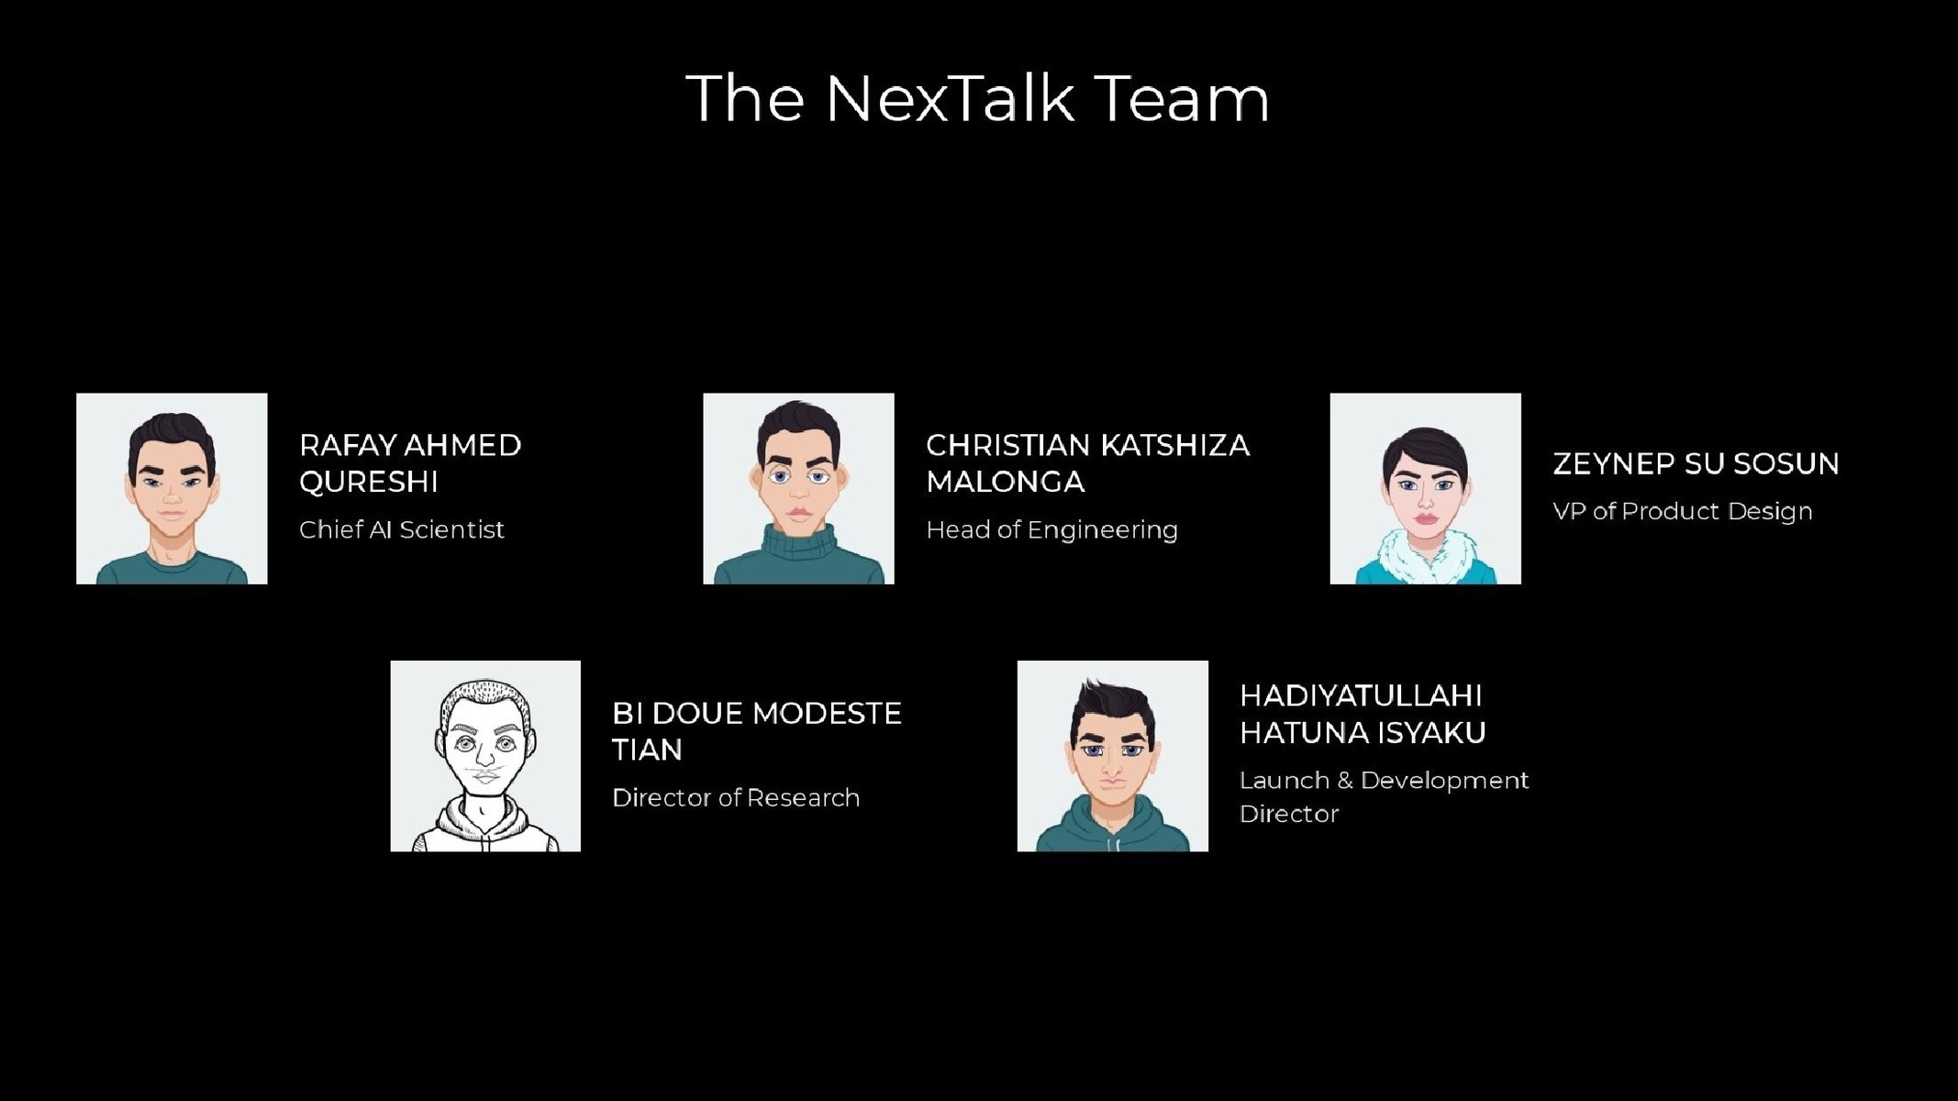

Slide 10

THANK YOU

